Slide 1
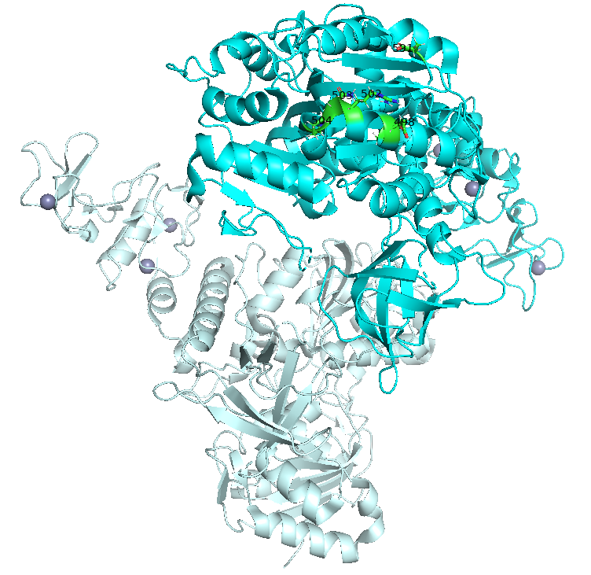



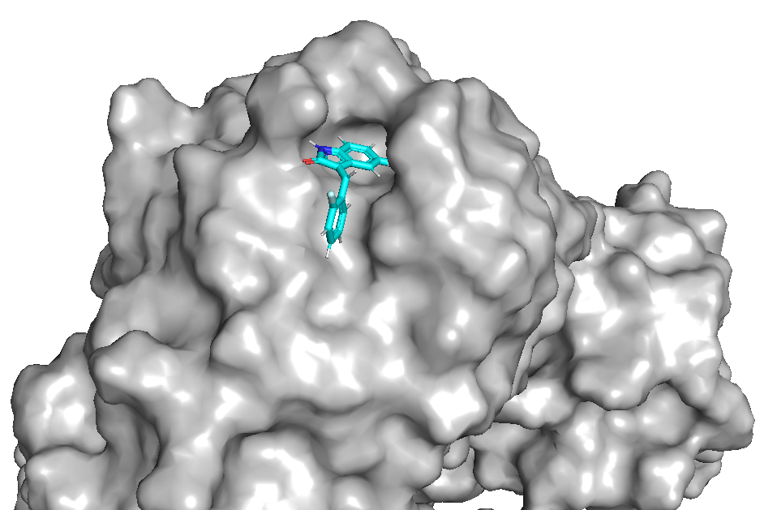
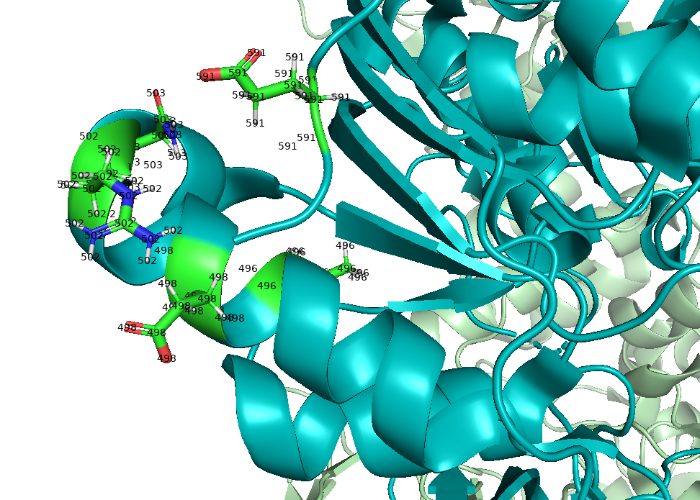
Open-Source Fragment-based Drug Discovery of Pan-Coronavirus Antivirals Assisted by Generative Machine Learning:
Targeting the SARS-CoV-2 Helicase (nsp13)
Follow on GitHub:
Tom Knight, Ph.D. Candidate in Medicinal Chemistry
Prof. Matthew Todd Research Group
Department of Pharmaceutical and Biological Chemistry
UCL School of Pharmacy

Slide 2
Fragment 3E
Notes:
6-fluoro-1-indanone (97%, 5 g, £27) and 2-fluorobromobenzene (100 g, £16) were ordered through iProcurement on Mon 30th May 2022.

Slide 3
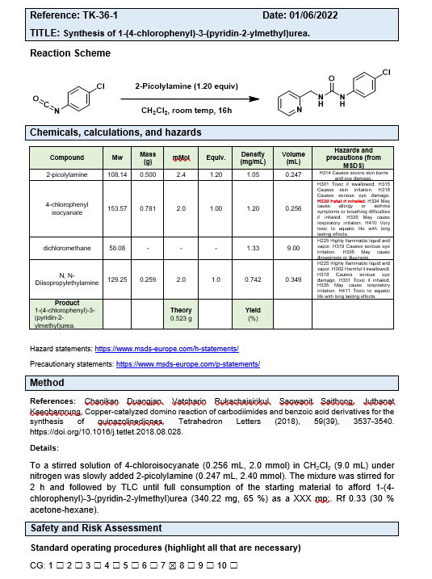
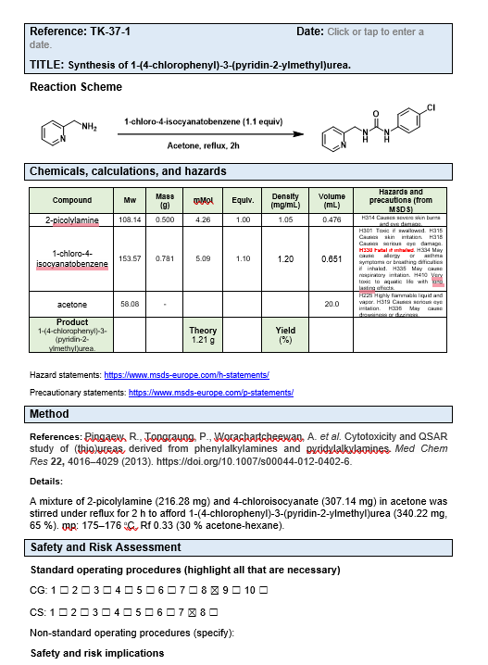
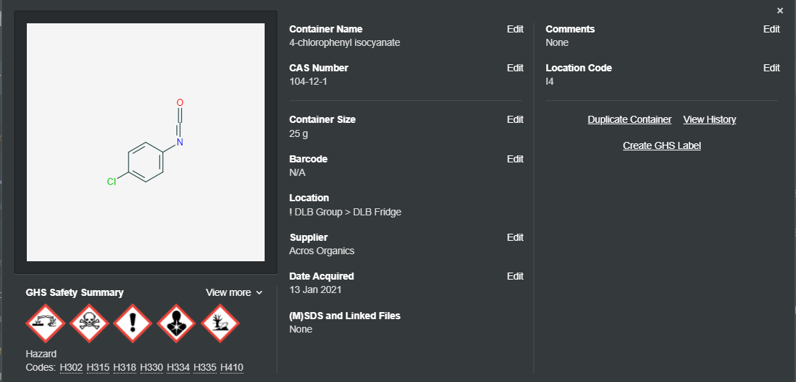
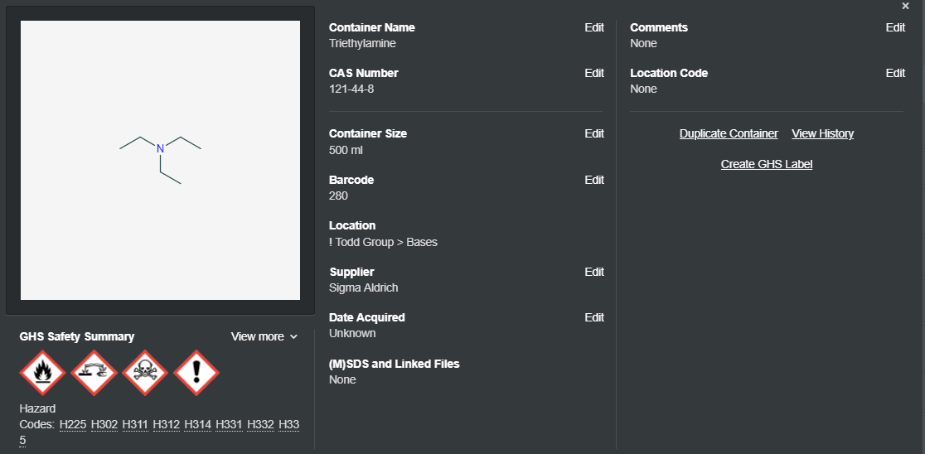
Fragment 3E: TK-36-1, TK-37-1

Slide 4
Fragment 25E
Notes:
NIS and 5-cyanoindole are available in-house in sufficient quantities (Fridge 2).
IBX (10 g, £27) and 1-bromo-4-flurobenzene (99%, 25 g, £11.78) were ordered through UCL marketplace on 30th May 2022.

Slide 5
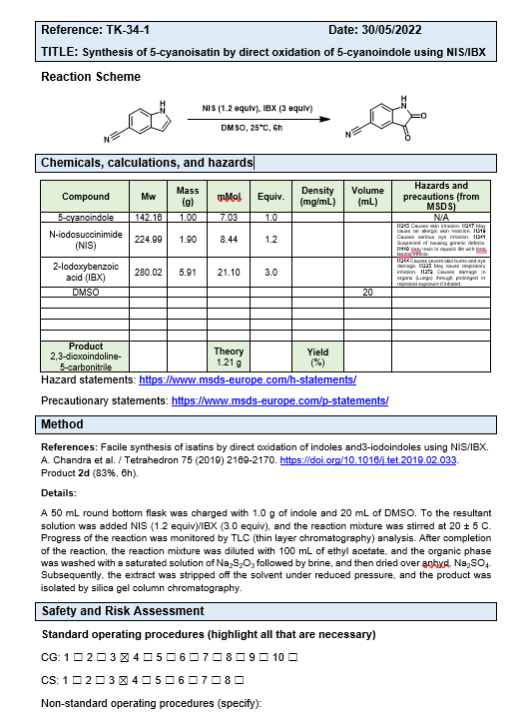
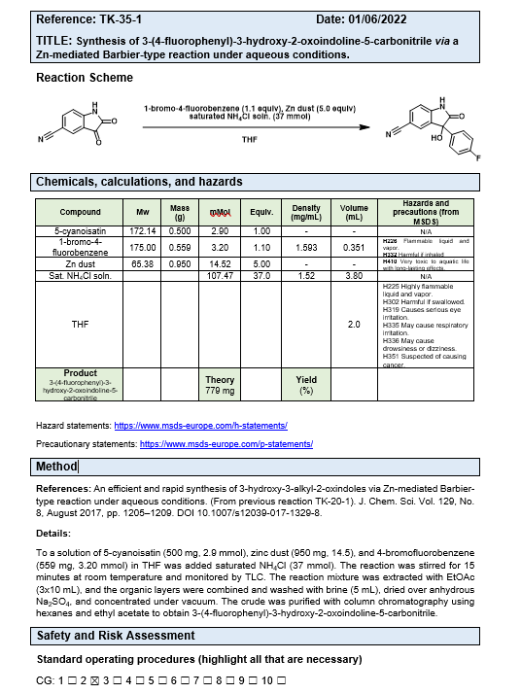
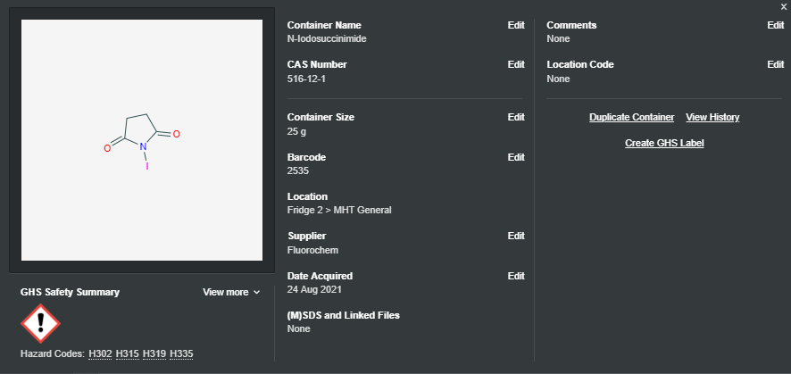
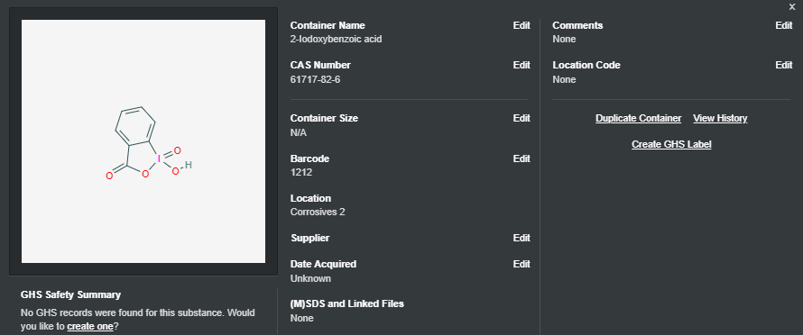
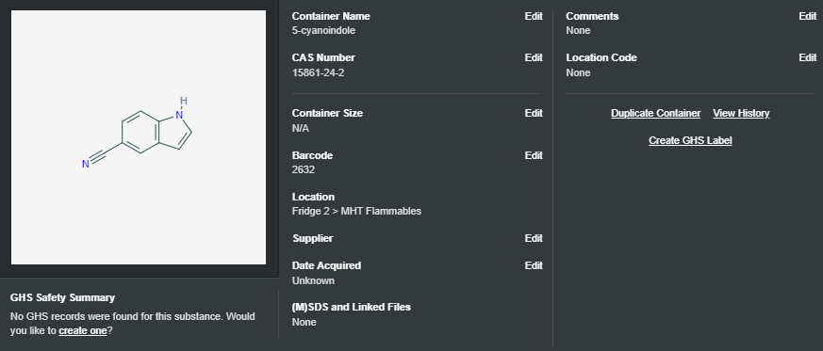
Fragment 25E: Reactions TK-34-1, TK-35-1.

Slide 6
Fragment 25E: TK-35-1 (backup Grignard route)

Slide 7
Fragment 6E / 17E
Notes:
6-fluoro-1-indanone (97%, 5 g, £27) and 2-fluorobromobenzene (100 g, £16) were ordered through iProcurement on Mon 30th May 2022.

Slide 8
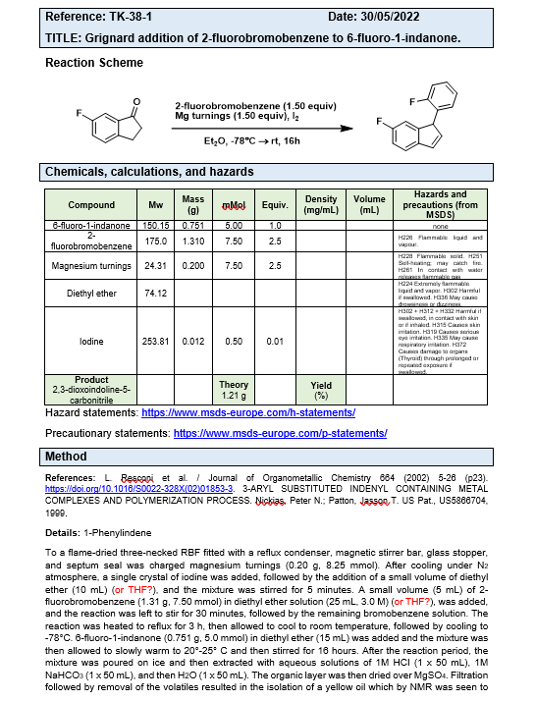
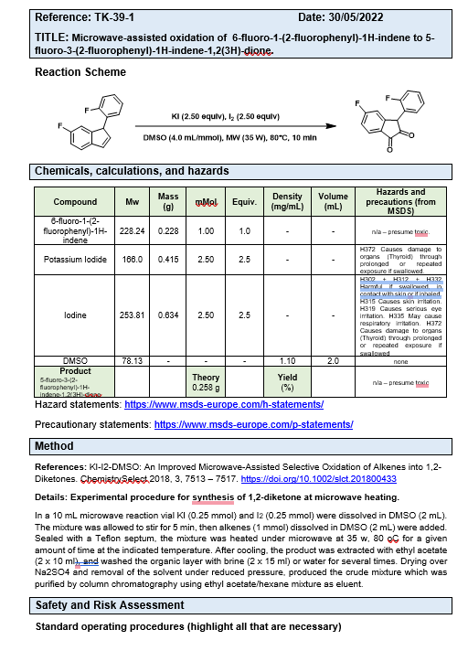
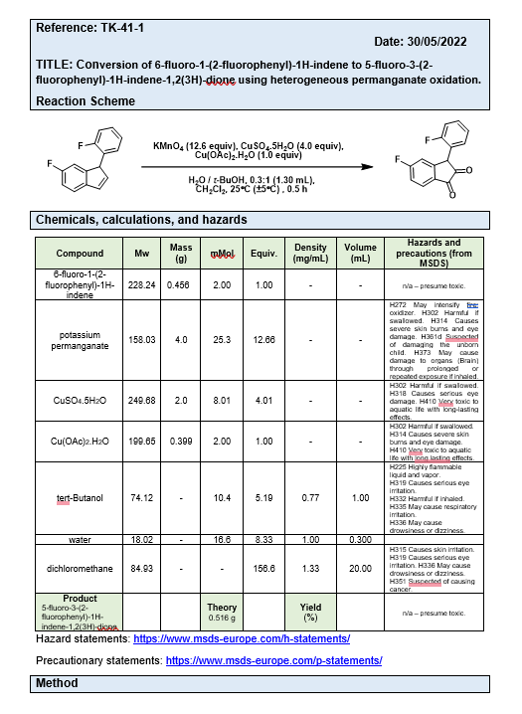
Fragment 6E / 17E: TK-38-1, TK-39-1, TK-41-1.
Notes:
6-fluoro-1-indanone (97%, 5 g, £27) and 2-fluorobromobenzene (100 g, £16) were ordered through iProcurement on Mon 30th May 2022.
KI-I2-DMSO: An Improved Microwave-Assisted Selective Oxidation of Alkenes into 1,2-Diketones.
ChemistrySelect2018,3, 7513–7517.
https://doi.org/10.1002/slct.201800433

Slide 9
Fragment 6E / 17E: Backup route.
Notes:
An expedient protocol for conversion of olefins to α-bromo/iodoketones using IBX and NBS/NIS
J. N. Moorthy et al. / Tetrahedron Letters 50 (2009) 2493–2496.
https://doi.org/10.1016/j.tetlet.2009.03.032
Oxidations with IBX: benzyl halides to carbonyl compounds, and the one-pot conversion of olefins to 1,2-diketones
J. N. Moorthy et al. / Tetrahedron Letters 47 (2006) 1757–1761.
https://doi.org/10.1016/j.tetlet.2006.01.039

